Slide 1
Spotlight
Bot
A Rice Hackathon 13 project by
Burkely Pettijohn and Nikita Naumov

Slide 2
TABLE OF CONTENTS
01
02
03
04
05
INTRODUCTION
PRODUCT DEMO
TECHNICAL DETAILS
IMPACT
NEXT STEPS

Slide 3

PROJECT INTRODUCTION
Goal: Develop a Discord Bot
Problem: The most engaging and memorable moments are lost in time by an endless amount of chatter
Tools: Leverage python packages such as discord.py and interfacing with the Discord API
Solution: Create a bot that recalls the pictures and videos that received the most reactions in the form of emojis or emotes

Slide 4
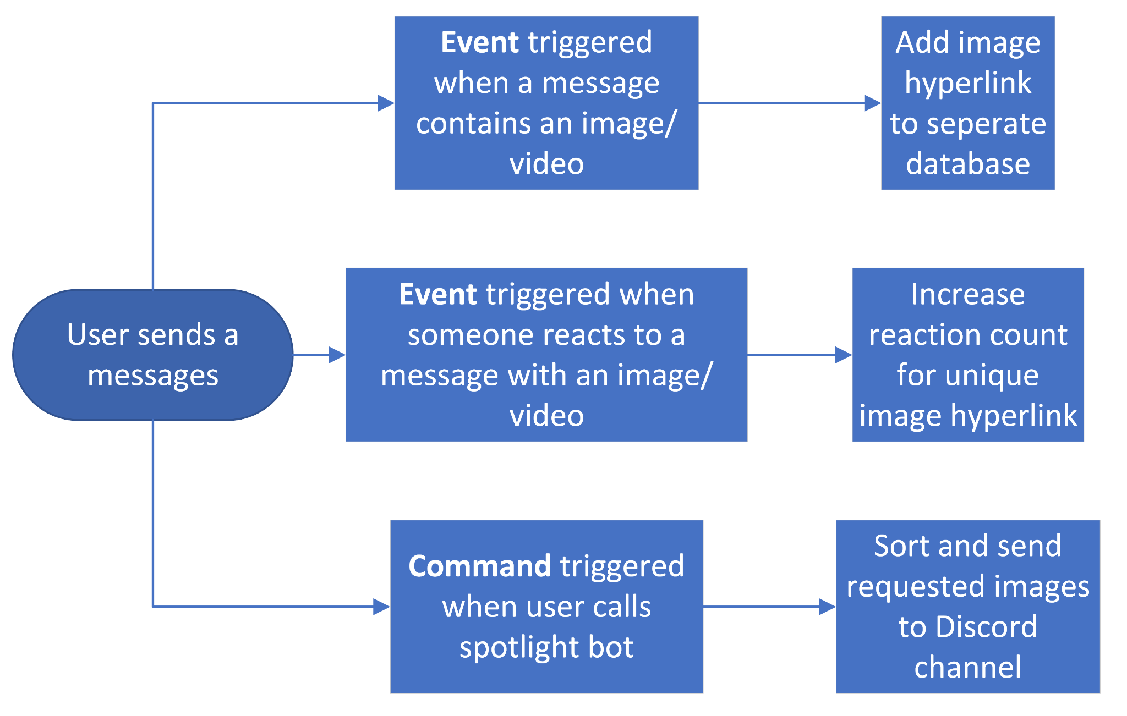
TECHNICAL DETAILS

Slide 5
IMPACT
EXPANDING TECHNICAL CAPABILITY
COMMUNITY EXPERIENCE ENHANCEMENT
Like Apple, Spotify, Snapchat, and numerous other social media networks, this bot organizes archived content and provides an easy way to view compilation of the most popular pictures and videos
Allow members to once again view moments throughout the history of their channel, which were marked by popularity and reactivity

Slide 6
NEXT STEPS
Identify a discord bot hosting service to run the bot code indefinitely
Establish a more capable database to contain the relevant media information
Allow the user to select a time range for the bot to pull the most popular images and videos from.
Develop the discord bot to compile all media into one video with the option to export

Slide 7
Thank you for the opportunity to compete at Rice Hackathon 13!!
Burkely Pettijohn -
linkedin.com/in/burkelyp
Nikita Naumov -
linkedin.com/in/nikita-naumov-716530192

